Slide 1


DESIGN YOUR OWN UNIQUE RESTAURANT!
STEMitUP Activity on Entrepreneurship

Slide 2
AMAZING AND SPECIAL RESTAURANTS FROM ALL OVER THE WORLD!

Slide 3
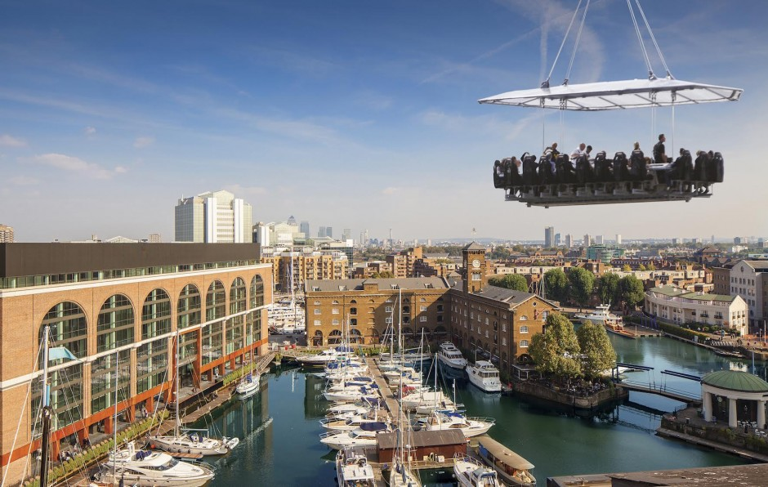
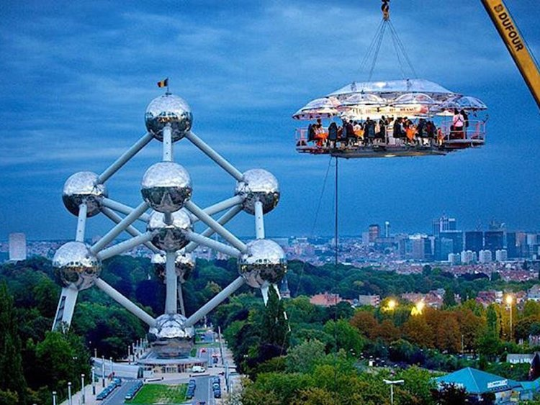
Dinner in the air!
Restaurant in London
Restaurant in Belgium

Slide 4
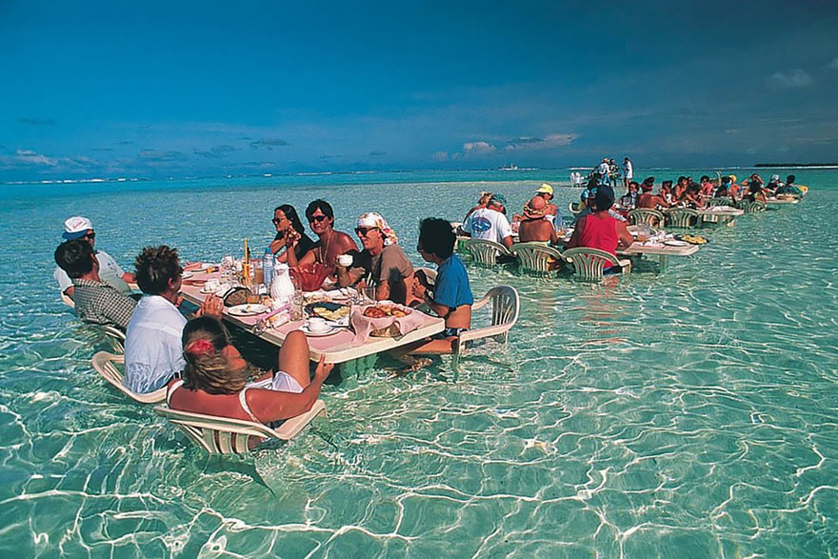
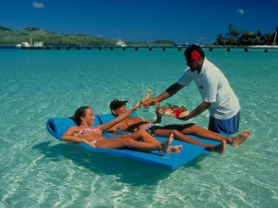
Lunch in the water!
Restaurant in Bora Bora

Slide 5
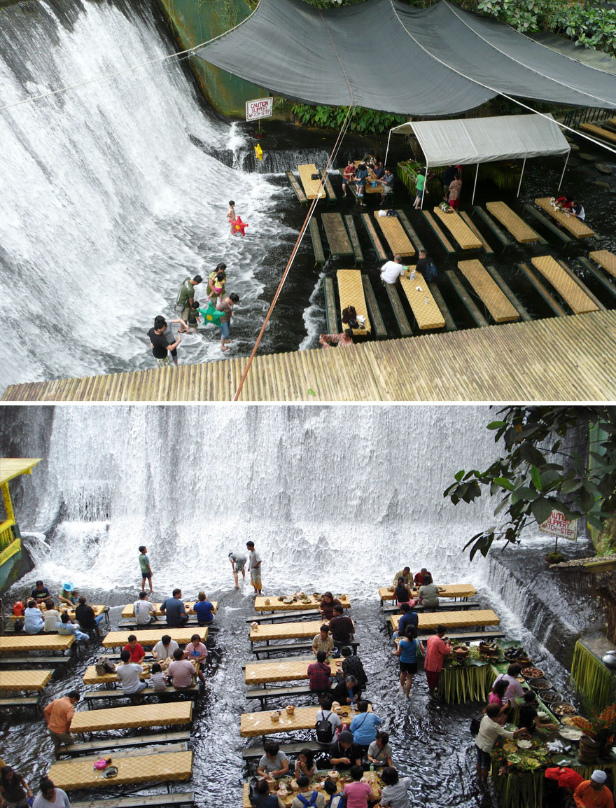
Dinner in the middle of a waterfall, Philippines

Slide 6
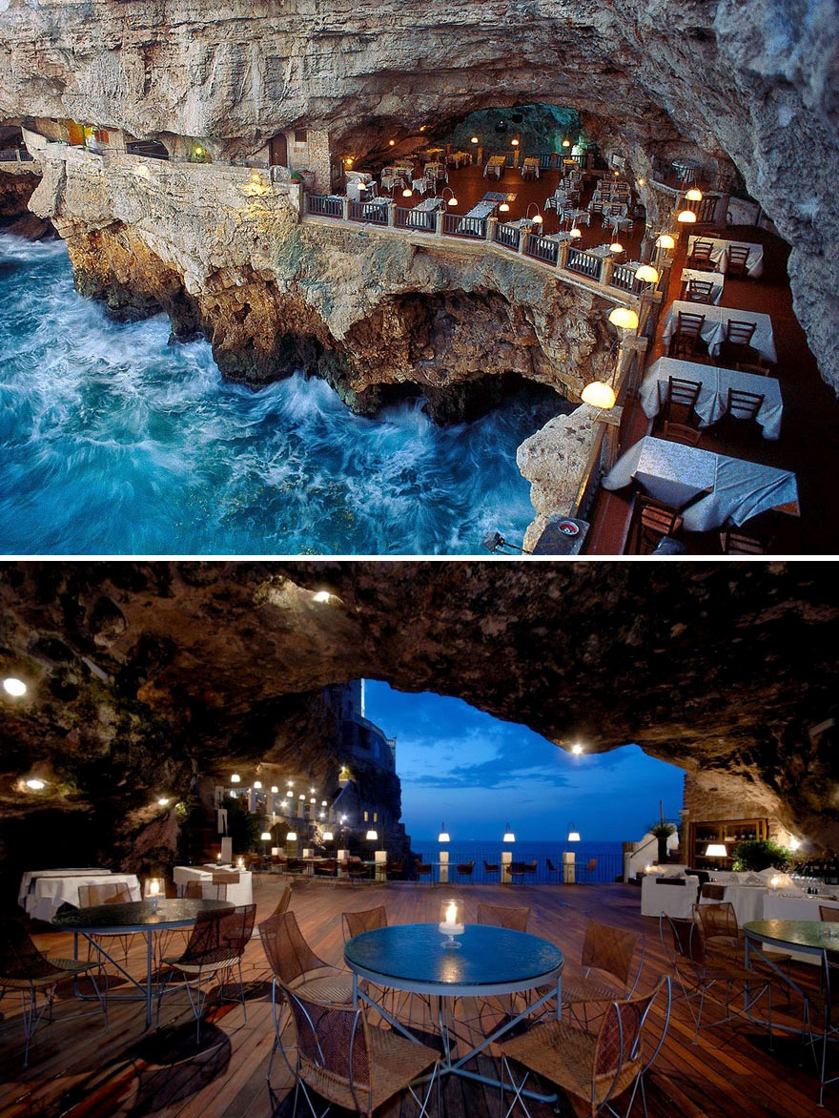
Dinner in a cave, Restaurant in Italy

Slide 7
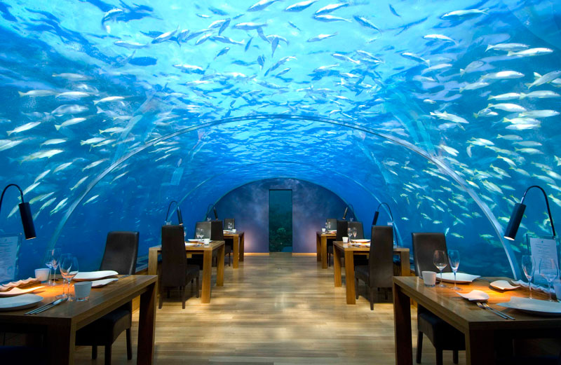
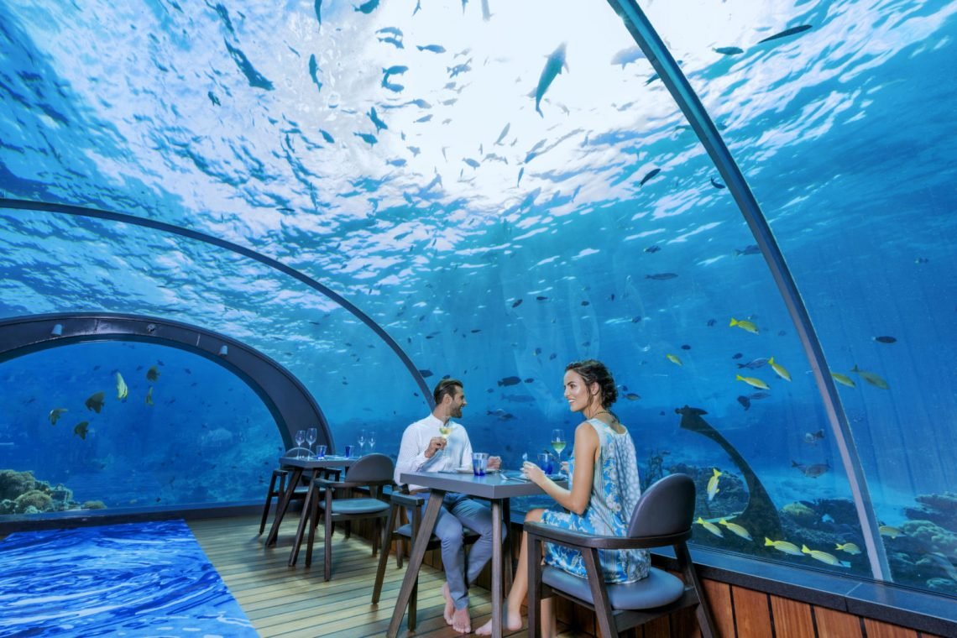
Lunch with the fish!
Undersea Restaurant in Rangali Island, Maldives

Slide 8
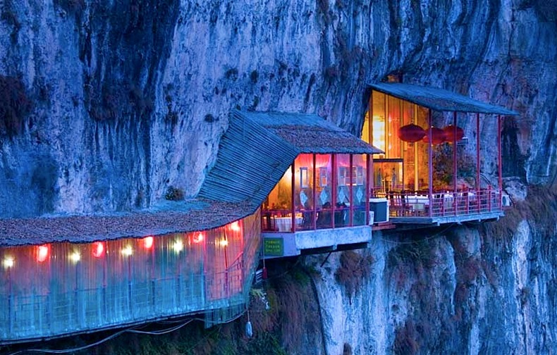
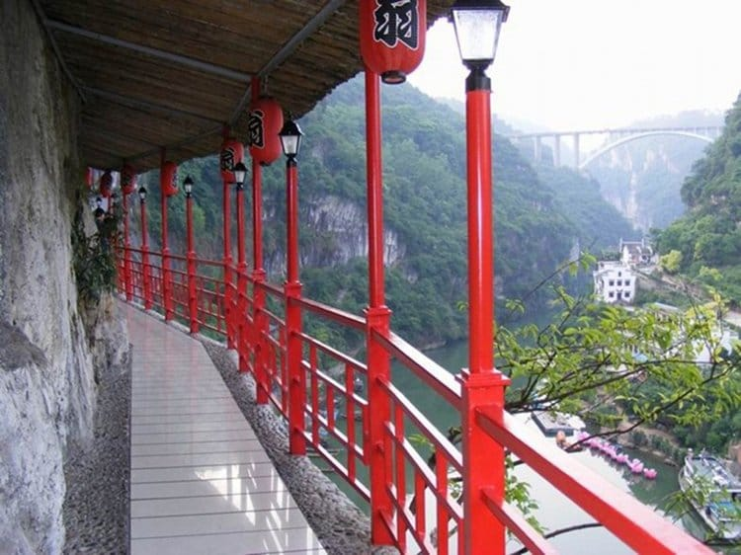
Mountain Restaurant in China

Slide 9
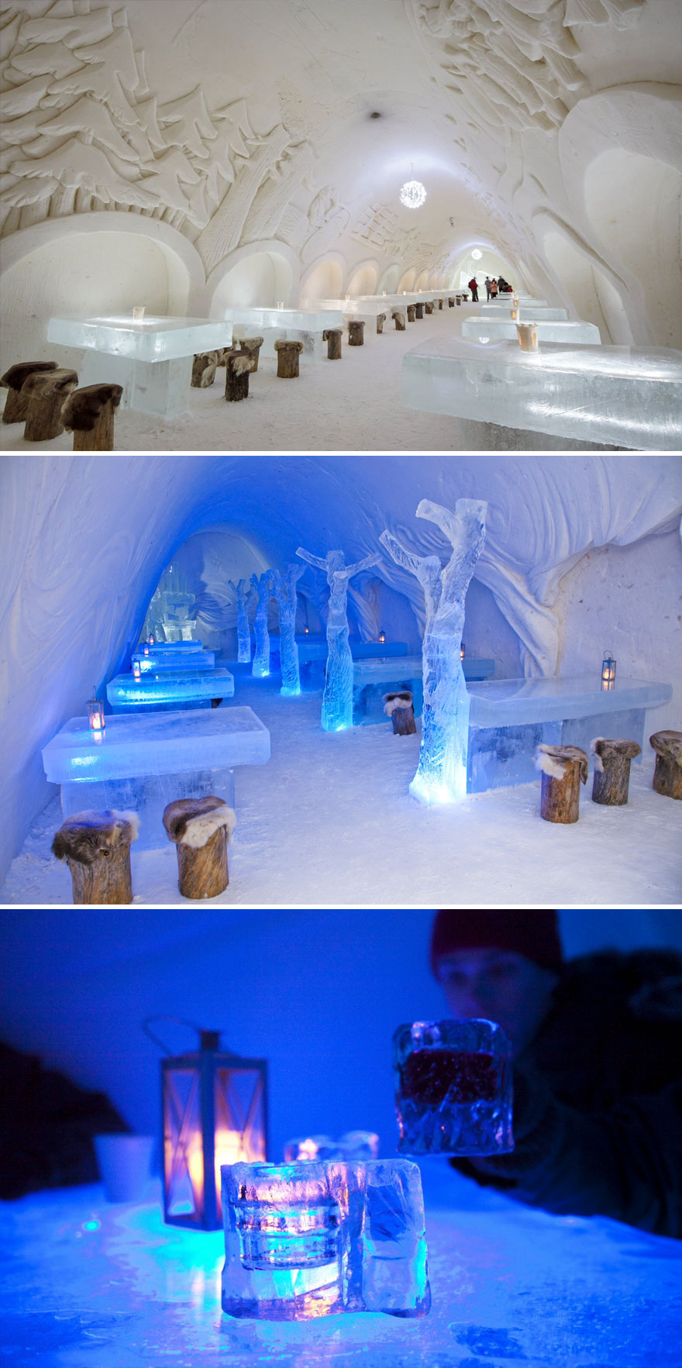
Dinner surrounded by snow and ice
Snow castle in Finland

Slide 10
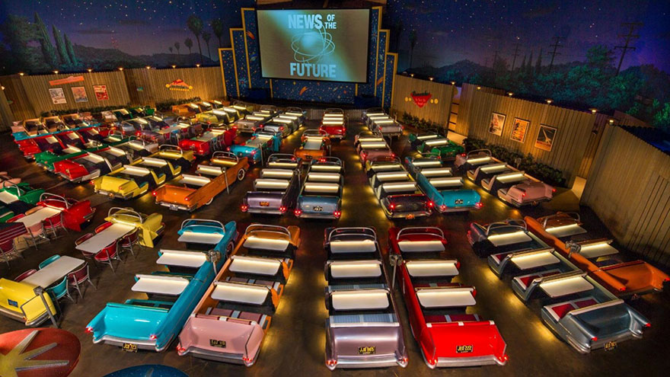
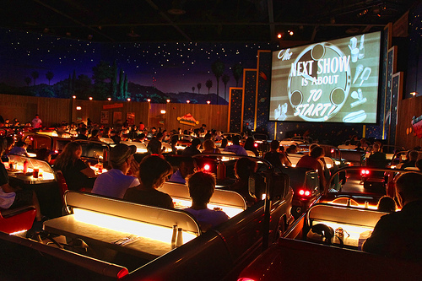
Dinner while watching movies in the Theatre Restaurant, Disney's Hollywood Studios, USA

Slide 11
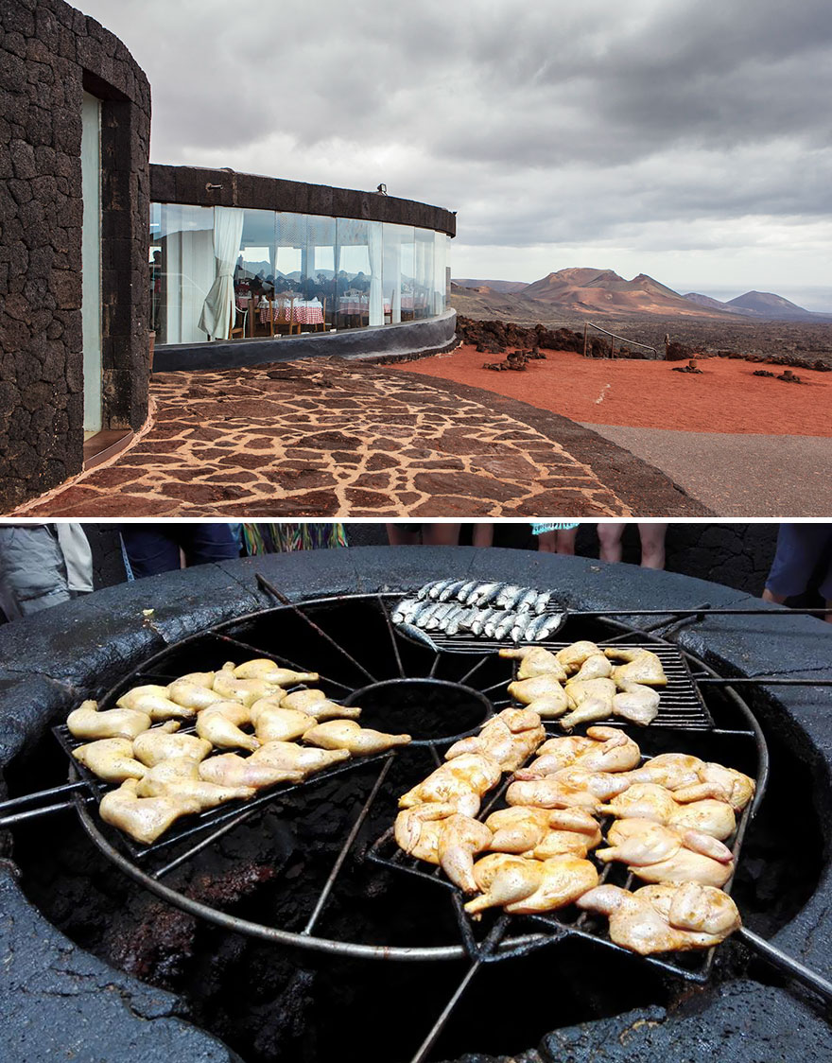
Restaurant built on a volcano in Spain

Slide 12
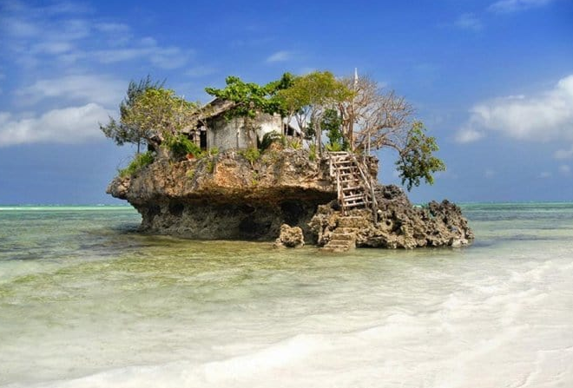
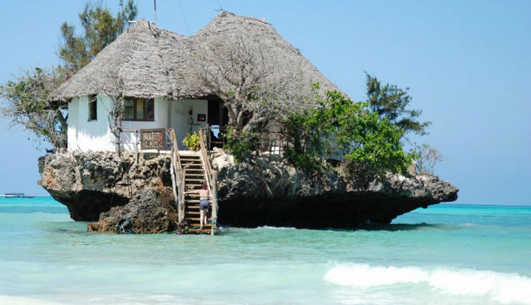
Restaurant ‘The Rock’ in Zanzibar, Tanzania

Slide 13
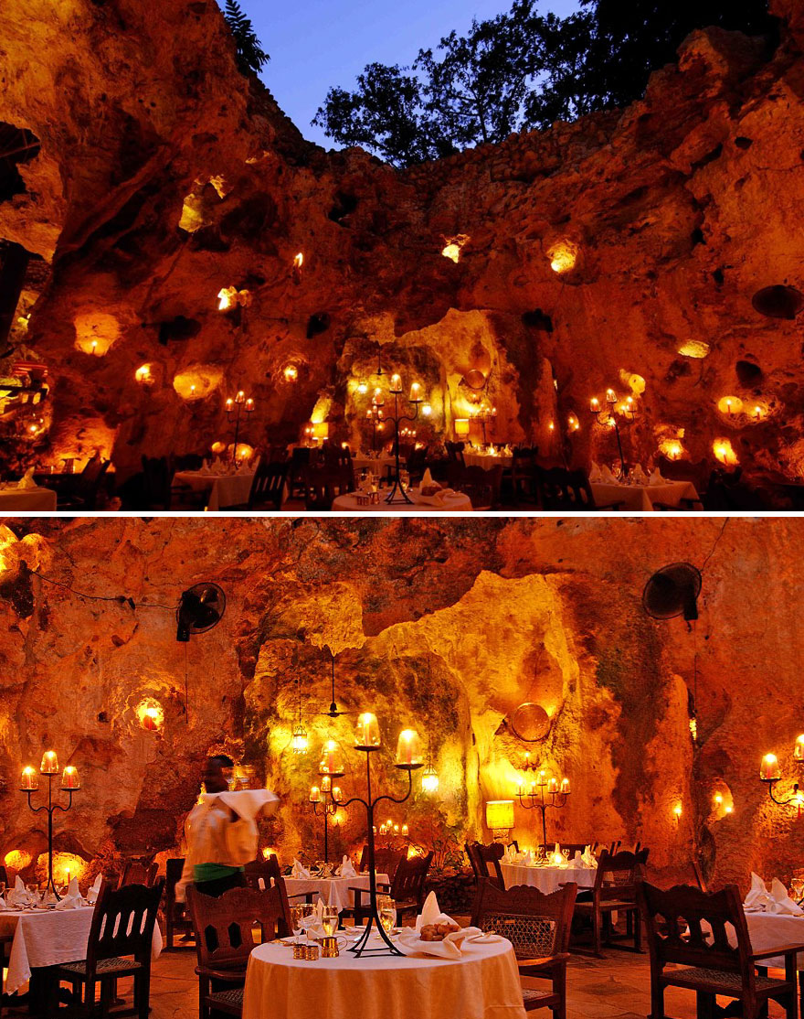
Cave Restaurant in Kenya
Set in an ancient cave and illuminated entirely by candle light

Slide 14
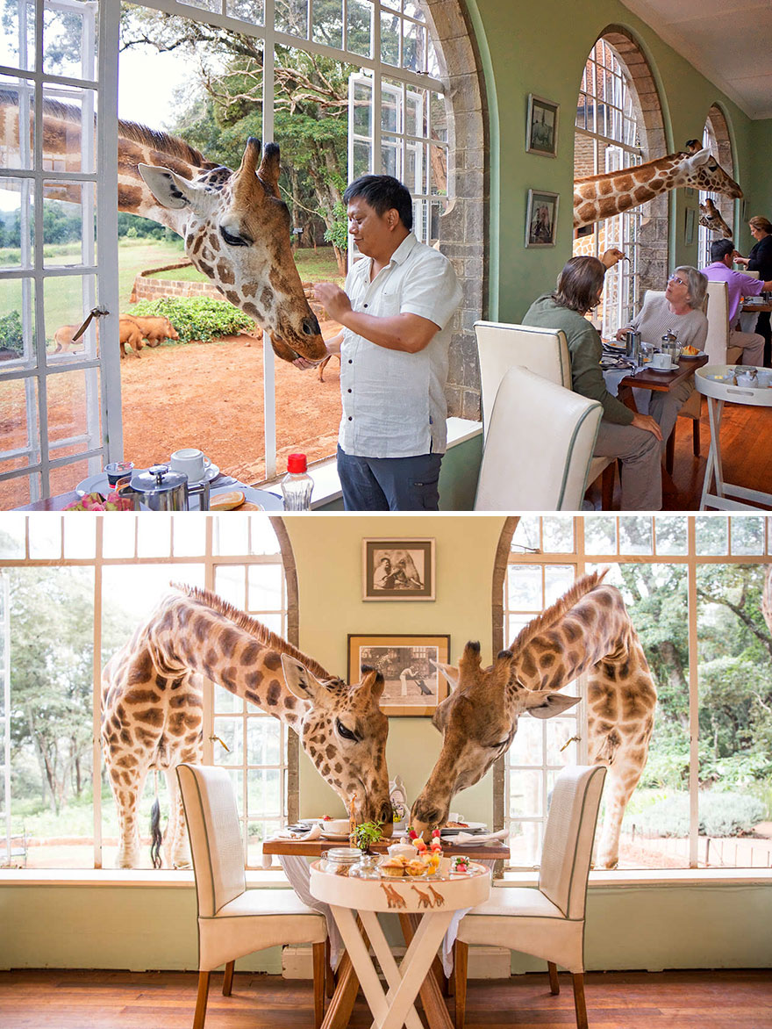
Share your breakfast with a giraffe, Giraffe Manor, Langata, Kenya

Slide 15
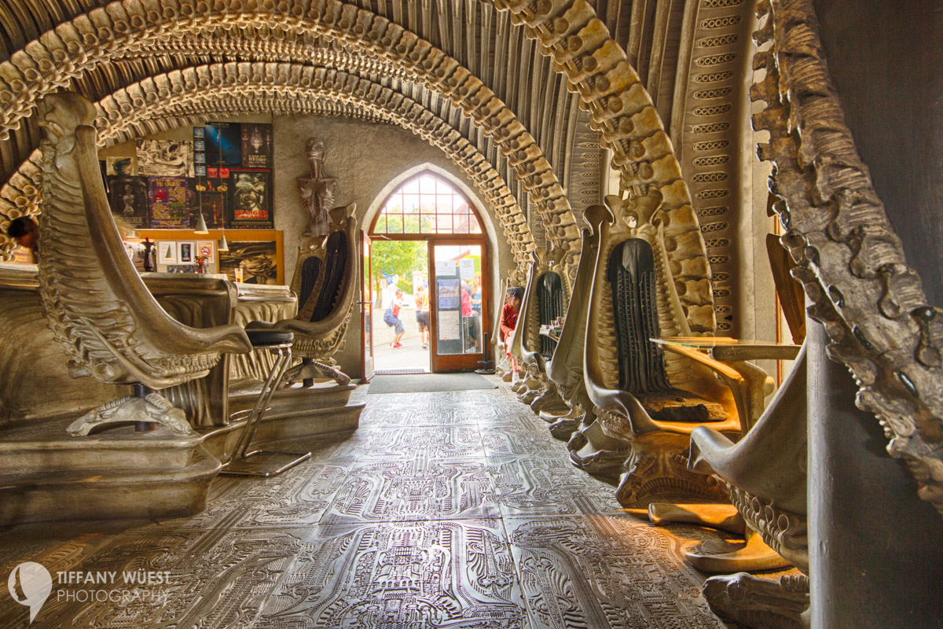
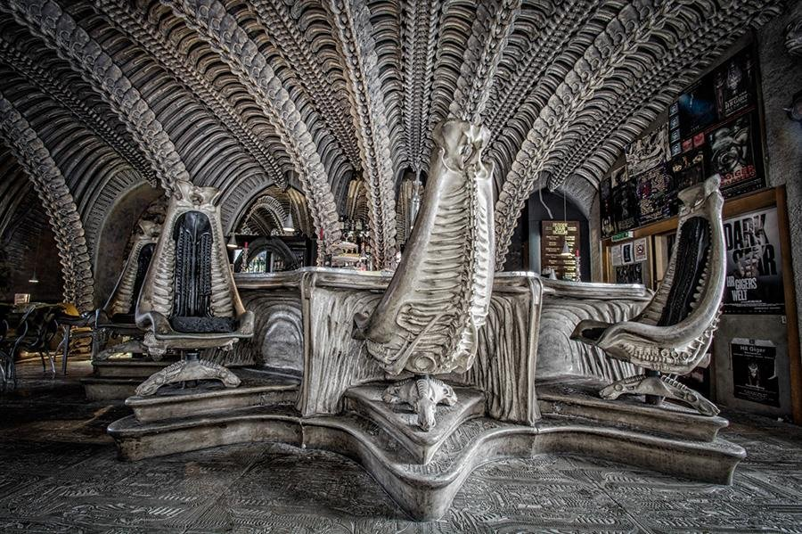
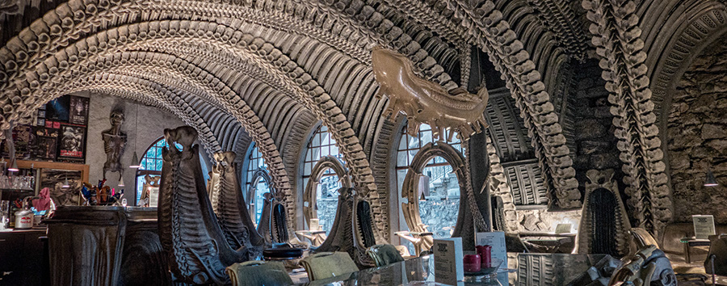
Museum Bar, Switzerland

Slide 16
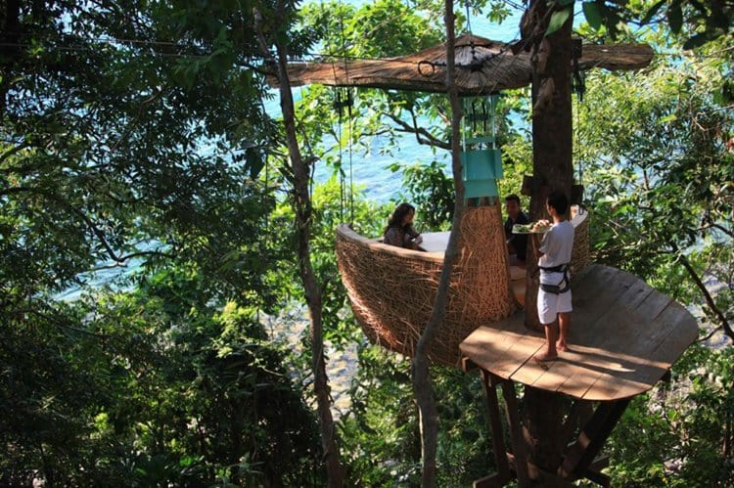
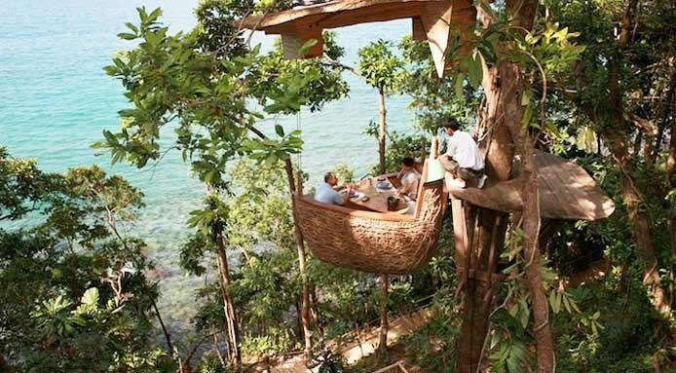
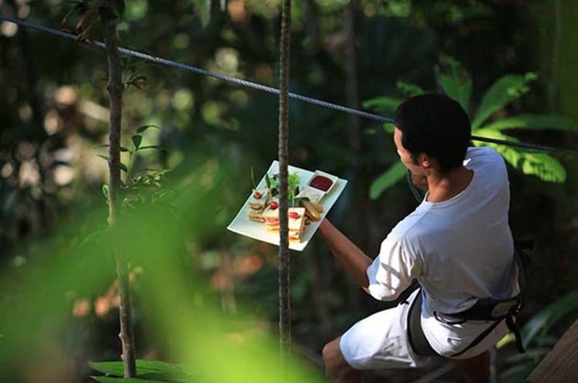
Fine Dining at a Treetop Restaurant in Thailand

Slide 17
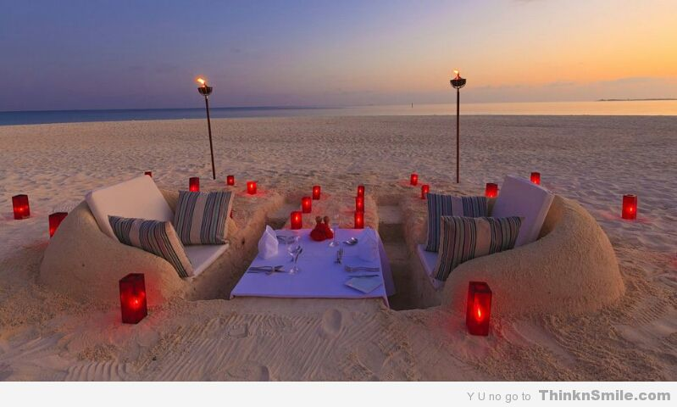
Dinner in the sand!

Slide 18
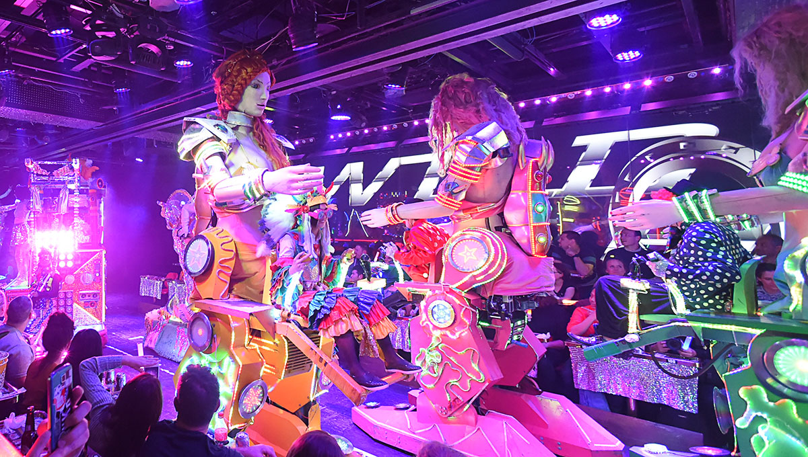
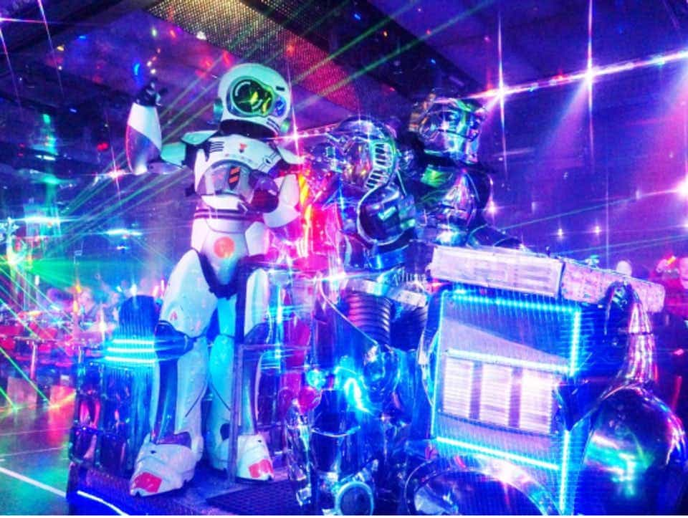
Robot Restaurant in China

Slide 19
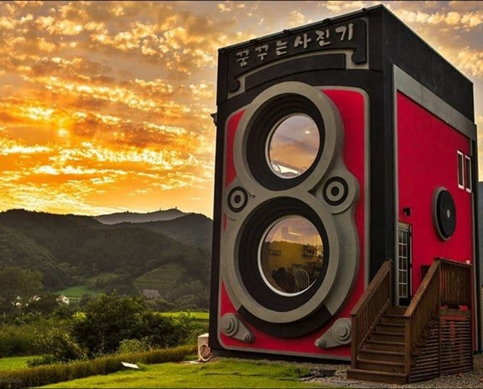
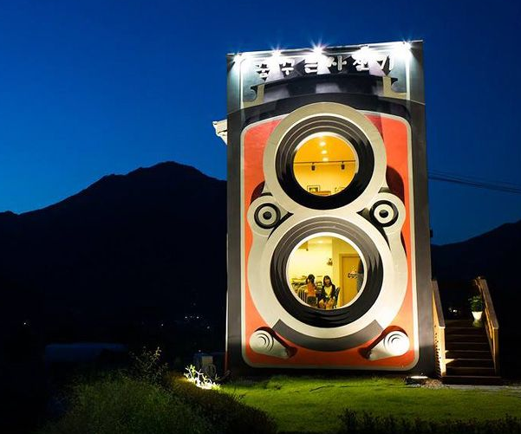
The Camera Cafe in South Korea

Slide 20


It's time to become entrepreneurs and create your own special restaurant!

Slide 21

Create the poster of your own restaurant with your team!
This about this first:
Who will be your main target customers?
Age
Men and /or Women
Young couples without children
Families with young children
Teenagers (14-18 years) with their friends
Elderly - Grandparents

Slide 22
What do they like to do in their free time?
Dancing
Singing
Climbing
Swimming
Cooking
Gardening
Taking Photos
Painting

Slide 23
Where will your restaurant be located?
GROUP A: Near, above or within the sea
GROUP B: Adjacent to a farm, in a traditional village

Slide 24

Now NAME your restaurant!

Slide 25
INSTRUCTIONS FOR
GROUP EXERCISE
You have 40’ to think about the exercise and draw a poster of your own restaurant
In the last 20'-25’ draw your restaurant in a poster
Then 1 or 2 kids from your team will present to us your restaurant poster within 3'
Tell us how the whole exercise was for your team!

Slide 26

Are you ready to present your restaurant to your friends ?

