Slide 1
Perfect Pitch
Identifying Variables

Slide 2
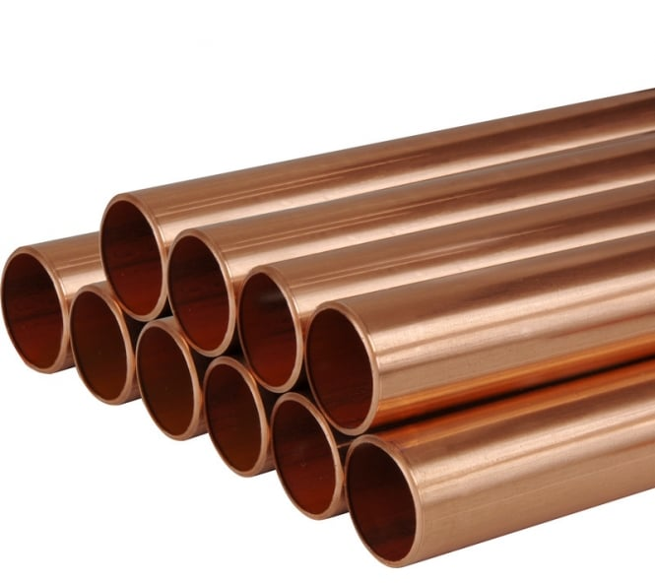
Pipes
A note can be made by tapping a pipe.
The frequency or pitch describes how “high” or “low” it is

Slide 3
Changing note
How do you make a different note? You have pipes of different lengths, materials and diameters.
Make some observations/ measurements and record in a table

Slide 4
Tables
Diameter (w, m, n) | Material | Length (s, m, l) | Pitch (H, M, L)

Slide 5
Use your findings to make a instrument
You have limited materials.
There is no one solution.
You may like to test some ideas
before you start.
Can you play a tune?

